Slide 1

CORESHARE

Slide 2
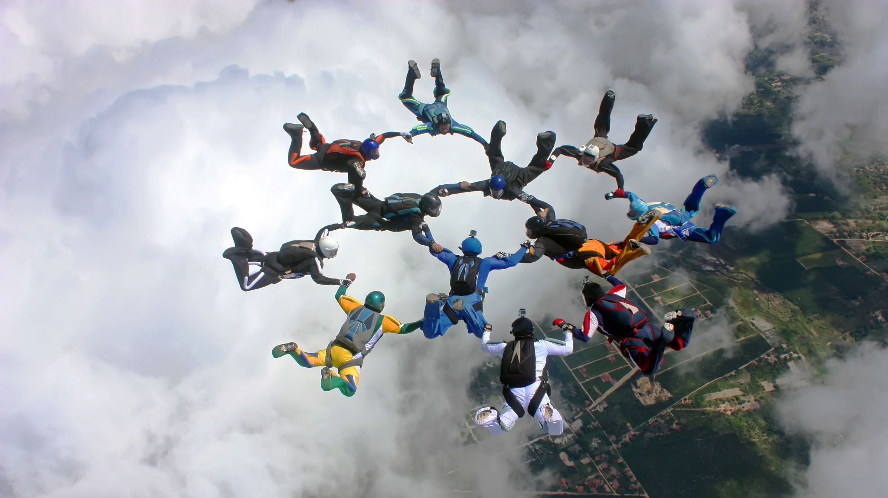
TEAM 25
Dominic Robbins – GitHub Master, Backend Developer
Victor Correa – Lead Frontend developer
Greydi Lora – Product Owner, Front End Developer
Mac Consolabe – Scrum Master, Team Lead
Michael Cevallos – Backend Developer

Slide 3

CoreShare Site
Core Share signup

Slide 4
Purpose
To create a social media website where:
Users can share text posts
Users can share music
Users can add their friends to a friends list
Search for other users
Target is music lovers who want meet others with similar tastes and general users of social media.

Slide 5
System Infrastructure
HTML, PHP, CSS, JavaScript
Spotify API
SQL for database construction
PhpMyAdmin served as backend server
Used Lamp server for deployment

Slide 6
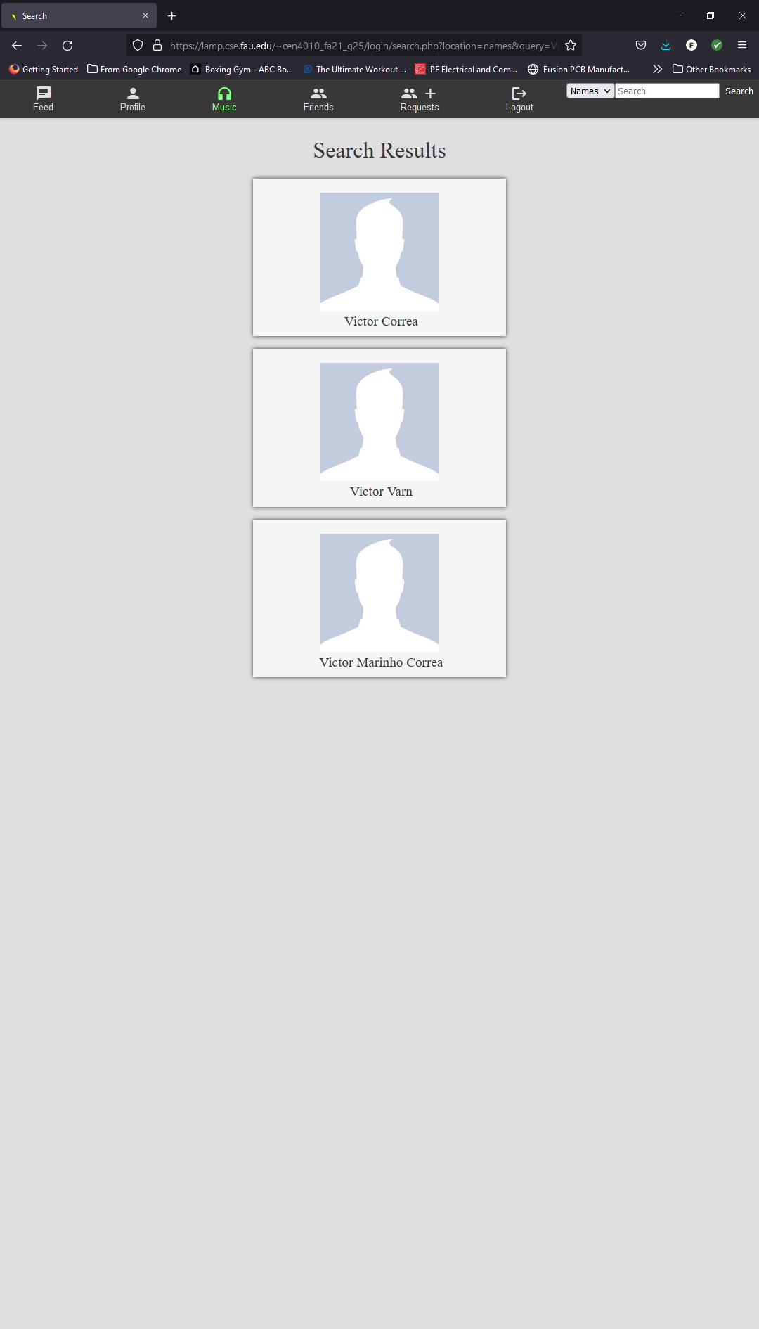
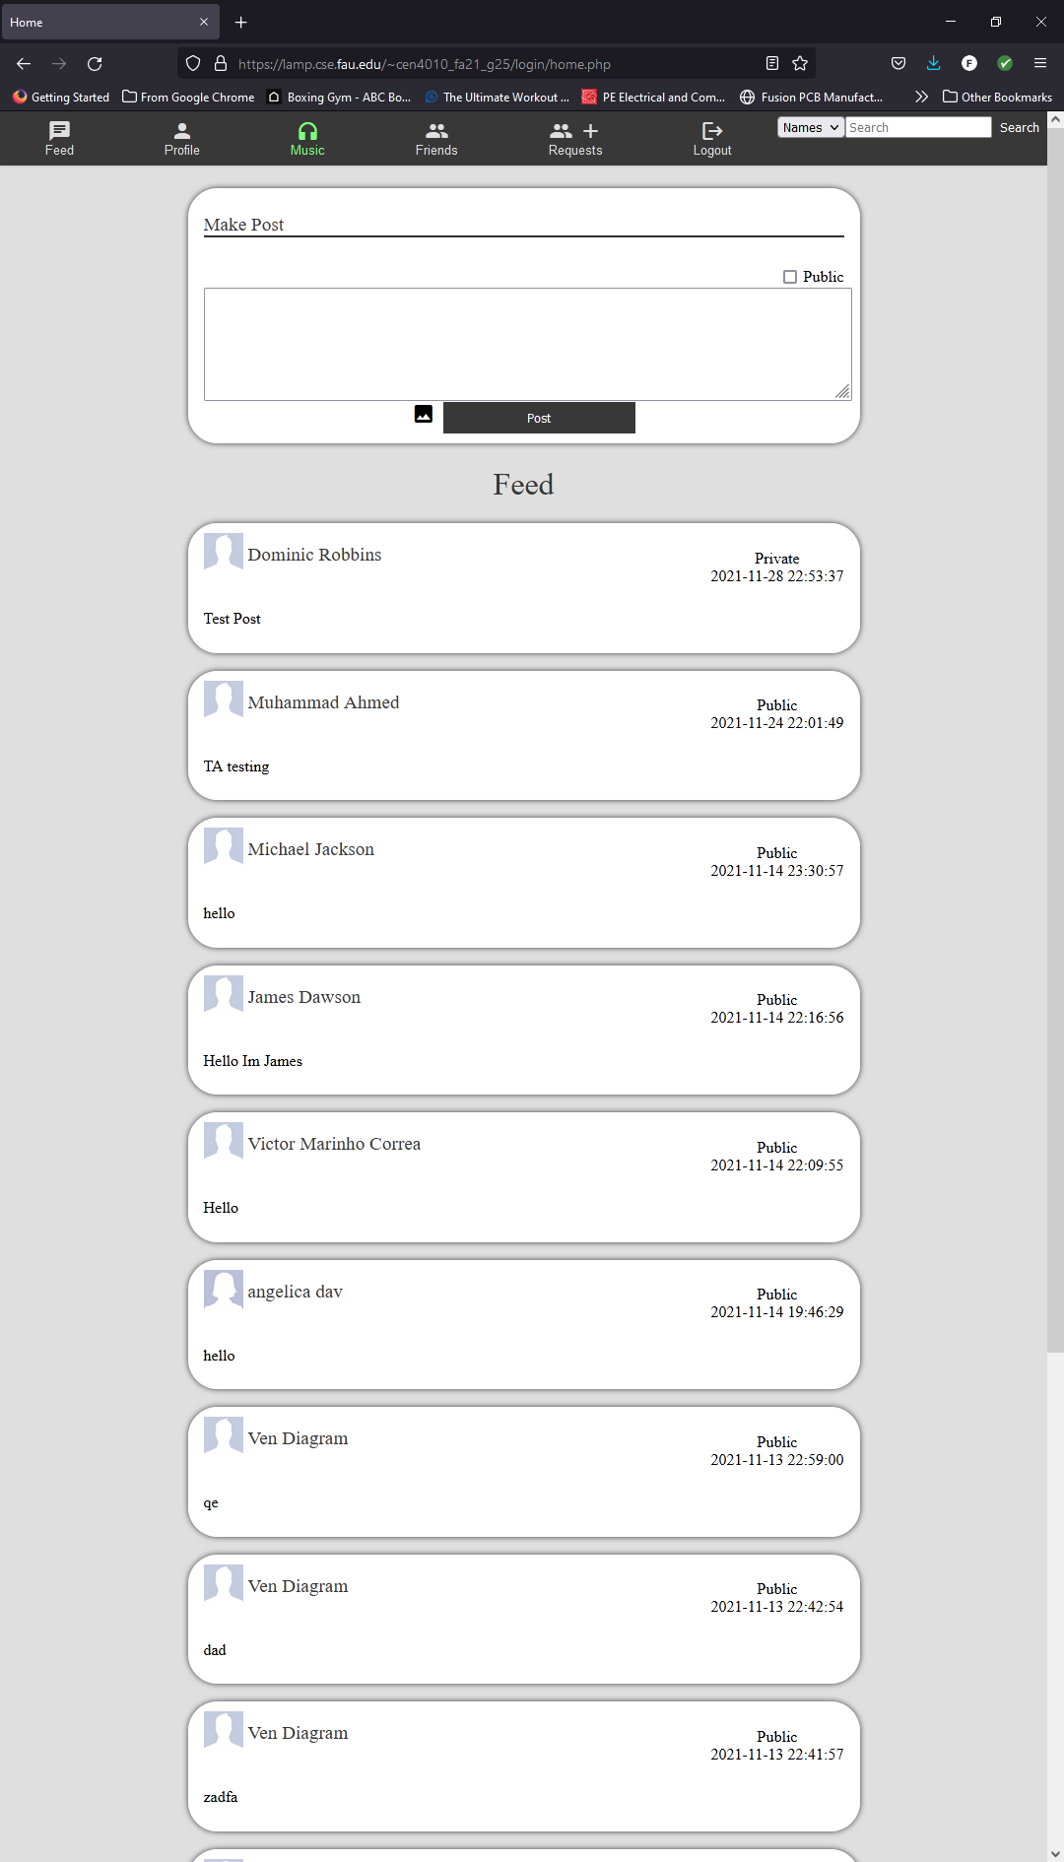
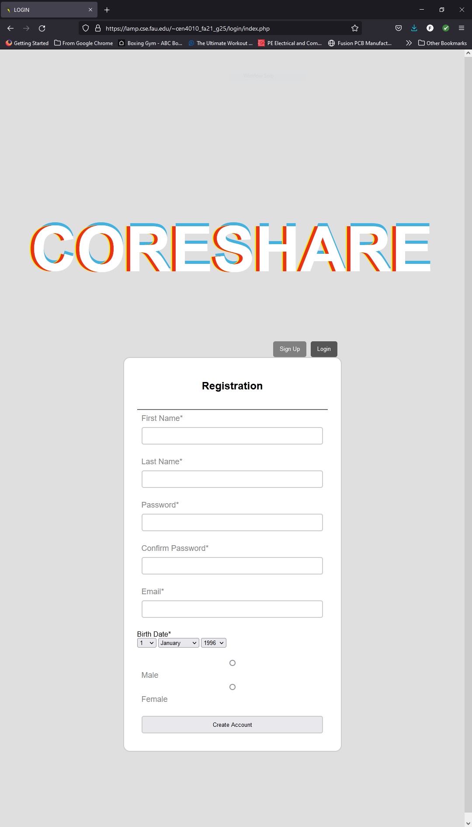
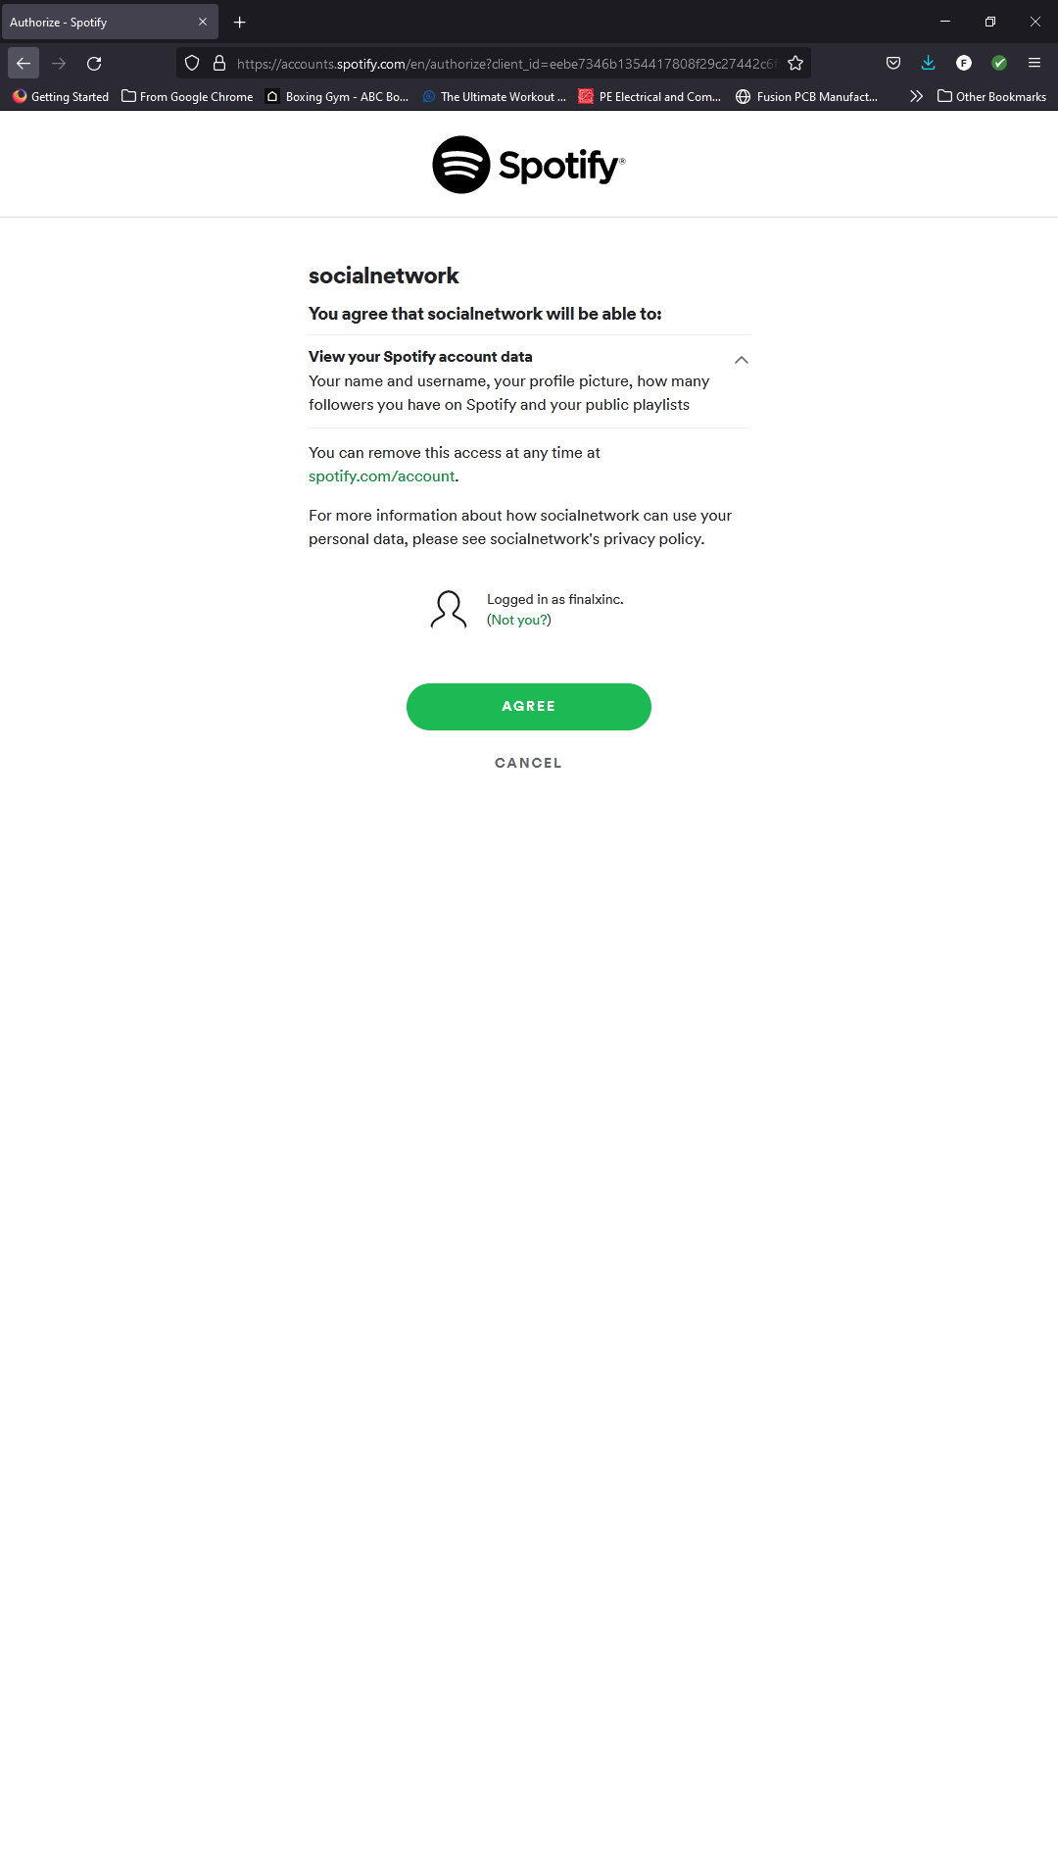
CoreShare as a Site

Slide 7
Non-Functional Requirments

Slide 8
Features
Implemented
1
2
3
Not Implemneted
1
2
3

Slide 9
Unfinished Features

Slide 10
Lessons Learned

Slide 11
Conclusion

